Slide 1

INSURANCE ANALYTICS
Presented By Ameya Vaidya

Slide 2
AGENDA
1
2
3
4
5
6
Summary
Steps
KPI List
Excel,
KPI
Suggestions
Performed
Power Bi
and Tableau
Dashboard
Observations

Slide 3

SUMMARY
In the Insurance Analytics Project, we focus on the insurance domain, analyzing the datasets, containing over 7,000 records in xlsx format.
We have identified and analyzed 6 Key Performance Indicators (KPIs)
Visualization tools used: Microsoft Excel, Microsoft Power Bi and Tableau.
Below are few practices which analyzed sales performance and track key metrics.
Monitor invoice count by Account Executive and yearly meeting count.
Assessed cross-selling, new business, and renewal metrics against targets.
Developed revenue-based stage funnel analysis for visualizing sales opportunities.
Tracked meeting counts by Account Executive and Identified top open opportunities for focused sales efforts.
Developed interactive dashboards using Advance Excel, Power BI and Tableau

Slide 4
STEPS PERFORMED
𝗗𝗮𝘁𝗮 𝗖𝗼𝗹𝗹𝗲𝗰𝘁𝗶𝗼𝗻 - Gather relevant data from the given data files and ensure data quality and consistency.
𝗗𝗮𝘁𝗮 𝗜𝗺𝗽𝗼𝗿𝘁 - Import collected data into Power BI/ Tableau/ Excel. Verify data import accuracy.
𝗗𝗮𝘁𝗮 𝗧𝗿𝗮𝗻𝘀𝗳𝗼𝗿𝗺𝗮𝘁𝗶𝗼𝗻 𝗮𝗻𝗱 𝗖𝗹𝗲𝗮𝗻𝗶𝗻𝗴 - Identify and address data inconsistencies, missing values, and outliers. Perform necessary data transformations, such as data type conversions and renaming.
𝗗𝗮𝘁𝗮 𝗠𝗼𝗱𝗲𝗹𝗶𝗻𝗴- Design a logical data model to support your analysis and visualization needs. Create relationships between different data tables if applicable.
𝗠𝗲𝗮𝘀𝘂𝗿𝗲 𝗮𝗻𝗱 𝗖𝗮𝗹𝗰𝘂𝗹𝗮𝘁𝗲𝗱 𝗖𝗼𝗹𝘂𝗺𝗻 𝗖𝗿𝗲𝗮𝘁𝗶𝗼𝗻 - Develop meaningful measures (aggregations) to analyze the data effectively. Create calculated columns for additional insights or custom calculations.
𝗗𝗮𝘁𝗮 𝗩𝗶𝘀𝘂𝗮𝗹𝗶𝘇𝗮𝘁𝗶𝗼𝗻 Choose appropriate visualization types (charts, graphs, tables) for your data. Create visualizations to represent key insights and trends.
𝗗𝗮𝘀𝗵𝗯𝗼𝗮𝗿𝗱 𝗖𝗿𝗲𝗮𝘁𝗶𝗼𝗻 Combine individual visualizations into a cohesive dashboard. Organize and arrange visuals for optimal user experience.
𝗙𝗼𝗿𝗺𝗮𝘁𝘁𝗶𝗻𝗴 𝗮𝗻𝗱 𝗦𝘁𝘆𝗹𝗶𝗻𝗴 - Apply consistent branding, colours, and fonts to maintain a professional appearance. Format visuals to enhance clarity and aesthetics.
𝗔𝗻𝗮𝗹𝘆𝘀𝗶𝘀 - Perform in-depth analysis using the created visualizations and measures. Answer specific business questions or explore trends and patterns.
𝗗𝗼𝗰𝘂𝗺𝗲𝗻𝘁𝗮𝘁𝗶𝗼𝗻 𝗮𝗻𝗱 𝗣𝗿𝗲𝘀𝗲𝗻𝘁𝗮𝘁𝗶𝗼𝗻 - Document the data sources, transformations, and modelling choices made. Prepare a presentation that explains the project, data insights, and the dashboard's value.

Slide 5
KPI LIST
KPI 1
KPI 2
KPI 3
KPI 4
KPI 5
KPI 6
Number of Invoice by Account Executive
Yearly Meeting Count
Cross Sell, New, Renewal – Target, Achieved, New
Stage by Revenue
Number of Meeting by Account Executive
Top Open Opportunity

Slide 6
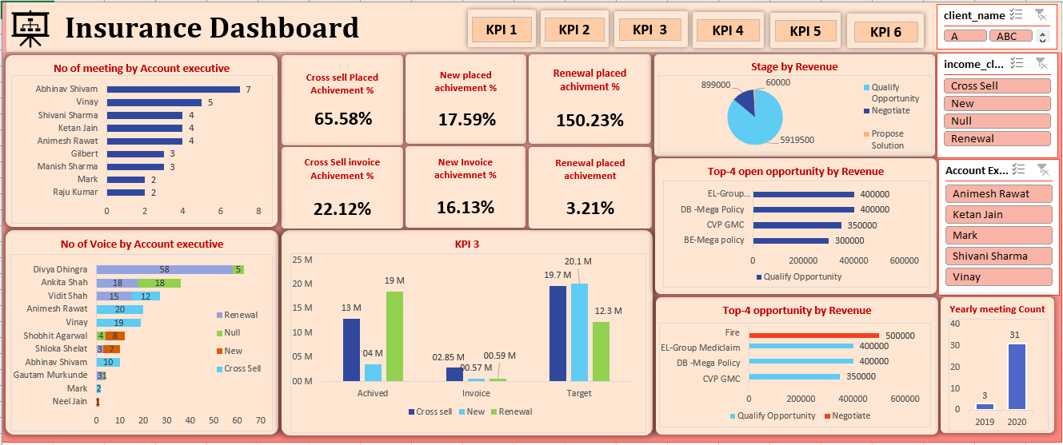
EXCEL DASHBOARD

Slide 7
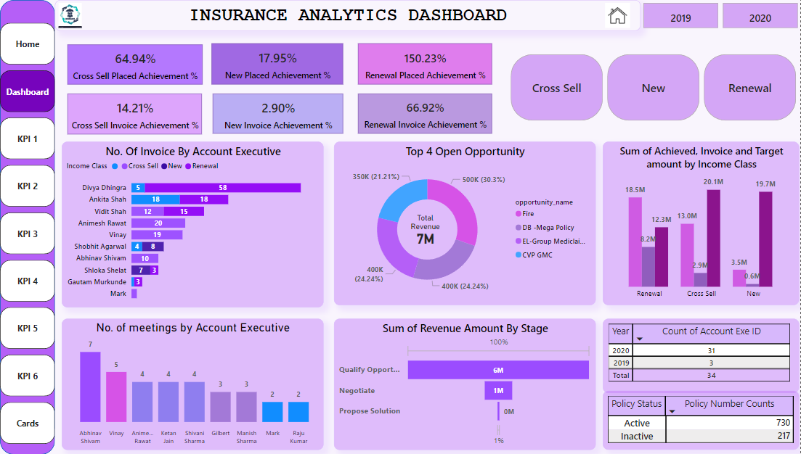
POWER BI DASHBOARD

Slide 8
KPI OBSERVATIONS
KPI-1 (Number of Invoice by Account Executive) : We have used bar chart visualization which indicates that’s Divya Dhingra has the maximum number of invoices i.e., 63 invoices.
KPI-2 (Yearly Meeting Count) : We have observed that in year 2019 only 3 meetings were held, while in 2020 total 31 meetings were conducted.
KPI-3 (Cross Sell, New, Renewal – Target, Achieved, New) : If we observe the overall Key performance indicator it shows that Renewal placed achievement i.e., 150.23% is more as there were more renewals and Cross sell placed achievement is 64.94% which is more when compared to new placed achievement. Hence, we can conclude that the account associates where good at pitching the clients with renewals and cross sales.
KPI-4 (Stage by Revenue) : We have monitored that Qualify Opportunity stage is leading with the maximum amount of revenue i.e., 5.92M
KPI-5 (Number of Meeting by Account Executive) : This KPI helps us to understand that executive Abhinav Shivam had conducted maximum meeting with the count 7 while executives Mark and Raju Kumar had conducted least count of meetings i.e., 2.
KPI-6 (Top Open Opportunity) : For this KPI we have considered TOP 4 open opportunity and here total revenue is 7M, also we can observe that Fire Opportunity has the maximum revenue amount 500K which is at the Top 1 opportunity while BE Mega opportunity has been placed on Top 4th position with revenue amount 300K

Slide 9
SUGGESTIONS
By providing comprehensive training to account executives on efficient invoicing practices, focusing on being accurate and getting them done on time.
Establish standardized procedures and templates for creating invoices to ensure consistency and minimize errors.
Utilize virtual meeting platforms to reduce travel time and facilitate remote collaboration.
Introduce performance-based incentives or recognition programs for account executives who consistently meet or exceed invoicing targets.
Celebrate team achievements to boost morale and motivation.
Consider how worldwide events like political changes, economic trends, or international trade policies might impact the competition in the market.

Slide 10
THANK YOU

